Slide 1
Seam Carving for Content-Aware Image Resizing and Video Retargeting
Qian Zhang, Wolong Yuan
Notes:
Good morning everyone, our project is seam carving for content aware image resizing and video retargeting

Slide 2

Introduction
Diversity of display devices requires images and videos to change sizes to fit into different displays
Notes:
Currently, we have many different display devices, like TVs, computers, phones, and watches. They have different display sizes. But images or videos typically remain rigid in size and cannot fit different layouts automatically. So sometimes we have the need to change their size.

Slide 3


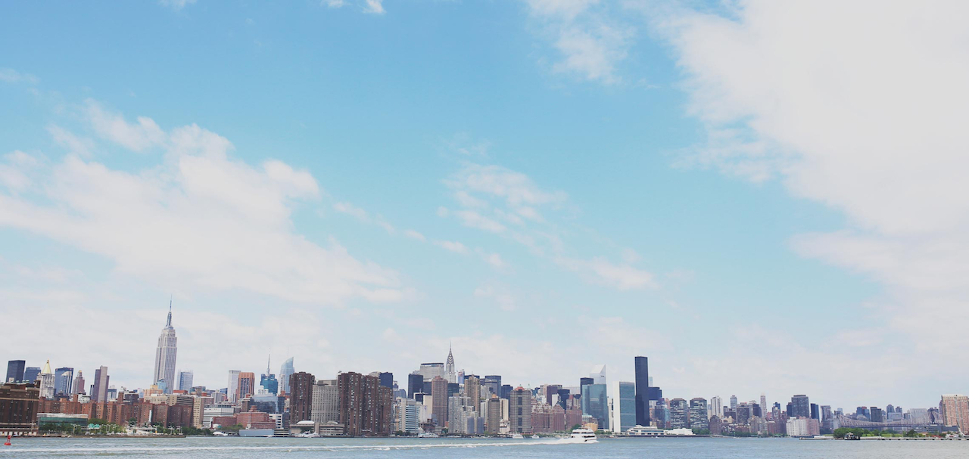

Introduction
Standard scaling produces and unwanted distortions and cropping cause important information loss
Scaling
Cropping
Notes:
There are some simple ways to change the size of images or videos. For example, scaling and cropping. But obviously they both have drawbacks. As we can see here, scaling is oblivious to image content and therefore produces distortions. And cropping can only remove pixels from image periphery, and will cause important information loss.

Slide 4
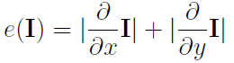

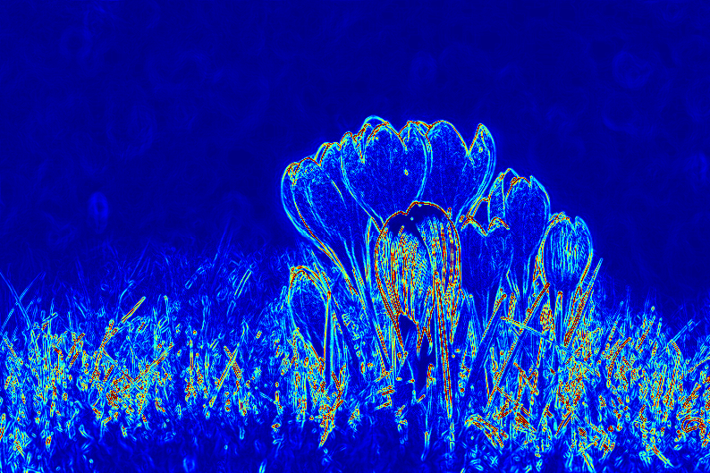
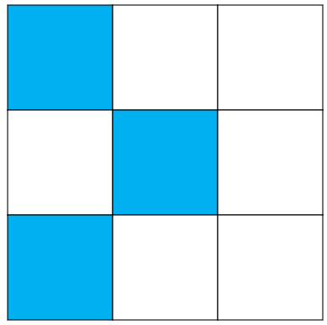
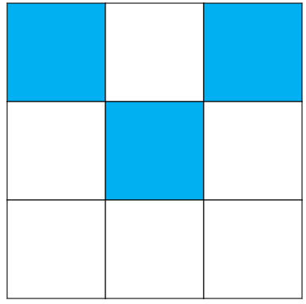
Content-aware image resizing
We implemented seam carving for content-aware image resizing[1]
Energy function:
Image
Energy map
Definition of seam:
Monotonicity and connectivity
Vertical seam
Horizontal seam
Notes:
So to get better and content-aware image resizing results, we implemented seam carving algorithm proposed by Avidan. The basic idea is that when we remove pixels to resize an image, we only remove pixels with low energy. One possible energy function is shown here. … Also, to avoid distortions, the pixels removed should have spatial monotonicity and connectivity, for example, to reduce the image width by one, there should be only one pixel removed in each row, and pixels removed should be connected. This is called seam.

Slide 5
Content-aware image resizing
We implemented seam carving for content-aware image resizing[1]
Objective: Removing seams with minimum energy
Approach:
Using dynamic programming to calculate cumulative minimum energy for all possible connected seams
(e.g. Resizing horizontally) Find minimum value of the last row in M and backtrack from this entry to find the optimal seam
Notes:
So, to reduce the image width by one, our objective is to find a vertical seam with minimum energy and remove it. The way to find the optimal seam is dynamic programming. Here, e is the energy of pixel (i,j), and these are the cumulative minimum energy of possible connected pixels in the previous row. And then, we can find the optimal seam by backtracking from the last row to the first row.

Slide 6
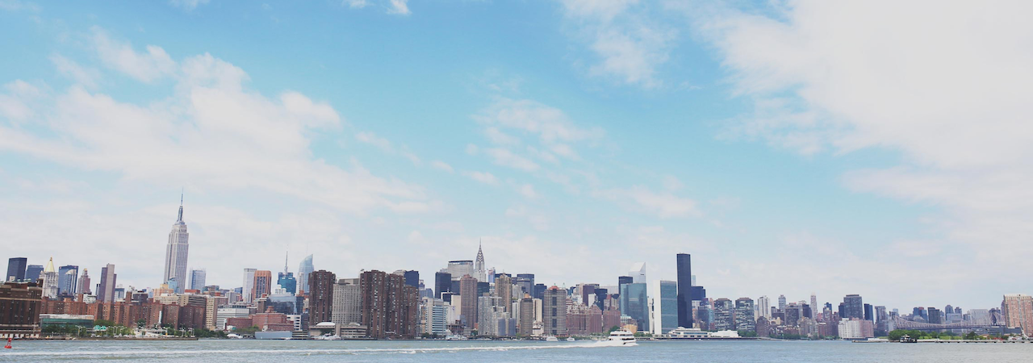


Results
Image Resizing
Skyline(reduced): 1280*450
Skyline(original): 1280*607
Flower. Left(original): 800*533,
Right(resized): 600*500
Skyline(expanded): 1280*800
Notes:
We implemented the algorithm using Python. Here are some results we got. This image is reduced vertically, and this image is reduced both vertically and horizontally. We can also use seam carving operator to expand image, which is just simply the inversion of seam removal.

Slide 7


Other Applications
Content Amplification
Cat(original): 800*541
Cat(content amplified): 800*541
Notes:
There are some other applications of seam carving, one is content amplification. We firstly scale the original image to a larger image. And then we use seam carving to reduce the enlarged image back to its original size.

Slide 8



Other Applications
Object Removal
Bus(original): 800*533
Bus(mask obtained with grabcut[3])
Bus(bw mask)
Bus(object removed): 800*533
Notes:
The other application is object removal. In this example, we use grabcut to get one object from this image, and then generate a mask from it. After that, we use the mask to assign the object pixels with a negative energy value, and reduce the size of the image until the object is removed. Finally, we expand the image to its original size.

Slide 9
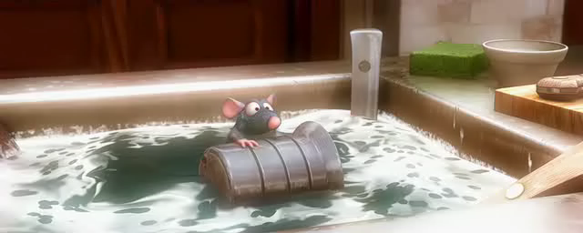
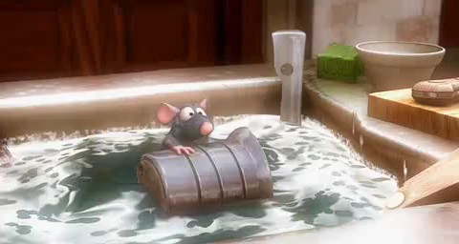
Video Result
Video(original): 640*256
Video(reduced): 480*256
Notes:
When it comes to video scenario, we can actually use seam carving to resize every frame and then combine the resized frames back to video. Let's see an example. This is the original video. And this is the video combined from resized frames. We can find the result has lots of distortions, this is because the seams we deleted in each frame don’t have temporal continuity.

Slide 10
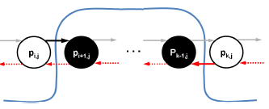
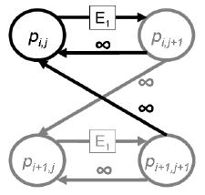
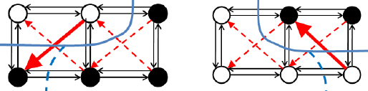
Video Retargeting
We implemented seam carving for video retargeting[2]
Dynamic programming can be defined as a graph cut problem while maintaining monotonicity and connectivity constraints:
Monotonicity[2]
Graph(Each node is pixel)[2]
Connectivity[2]
Notes:
So we implemented improved seam carving algorithm proposed by Rubinstein to handle resizing of video. Video can be seen as a 3d volume, and in this case, dynamic programming can’t be used, so we need to use graph cut algorithm to find a 2d manifold in the video volume. But firstly, we can show graph cut can be equivalent to dynamic programming in the image scenario. Here, every node is the graph is a pixel, and E is the energy defined as before, and is the cut cost here, and these backward infinity weights are meant to guarantee monotonicity and connectivity, so here our objective is to find a cut with minimum cost. We can easily extend this setting to video, we can build this kind of graph in every frame, and between frames

Slide 11
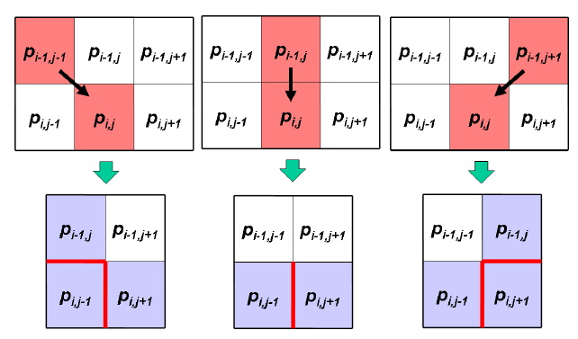
Video Retargeting
We implemented seam carving for video retargeting[2]
Forward energy considering inserted energy when deleting seams:
Cases where energy are inserted[2]
Notes:
Rubinstein also proposed a better cost function which not only considers energy deleted but also energy inserted when new edges are formed. There are 3 cases where new edges are formed when we delete pixels, and new energy are inserted

Slide 12
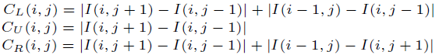
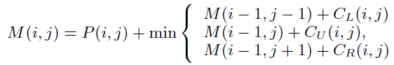
Video Retargeting
We implemented seam carving for video retargeting[2]
Forward energy in dynamic programming:
Possible inserted energy
Cumulative minimum energy
Notes:
We can use forward energy in the dynamic programming described as before. Here, CL, CU and CR are the possible inserted energy when we delete pixel (i, j) and one pixel in the previous row, which correspond to three cases in the previous slide. M is the cumulative energy, here, we not only consider the energy deleted but also the energy inserted.

Slide 13
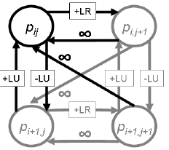
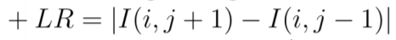
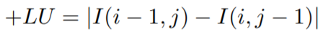
Video Retargeting
We implemented seam carving for video retargeting[2]
Forward energy in graph cut:
When pixel (i,j) is deleted, energy inserted by left and right neighbors
and energy inserted by left and upper neighbors (upward vertical)
and energy inserted by left and lower neighbors (downward vertical)
Notes:
Here, in graph cut, if we use energy inserted as cost, then the weights are defined in this way, for example, if we deleted pixel (i,j) then there are 3 possible costs. And we can expand this kind of graph to video as before.

Slide 14



Image Result
Image Resizing
Seam carving: 256*342
Improved seam carving: 256*342
original: 512*342
Notes:
We implemented the algorithm using Python, when applying the graph cut algorithm, we use PyMaxflow package.
Here are the image results when we used seam carving which only considers energy deleted, and when we used improved seam carving operator. This result has better visual quality.

Slide 15
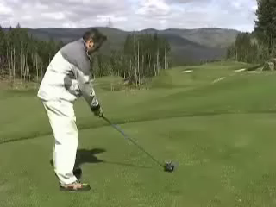
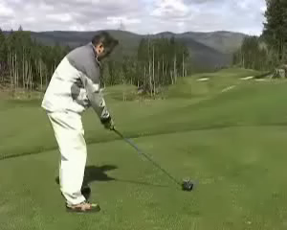
Video Result
Video Retargeting
original: 320*240
Video retargeting: 300*240
Notes:
Here are the video results.

Slide 16
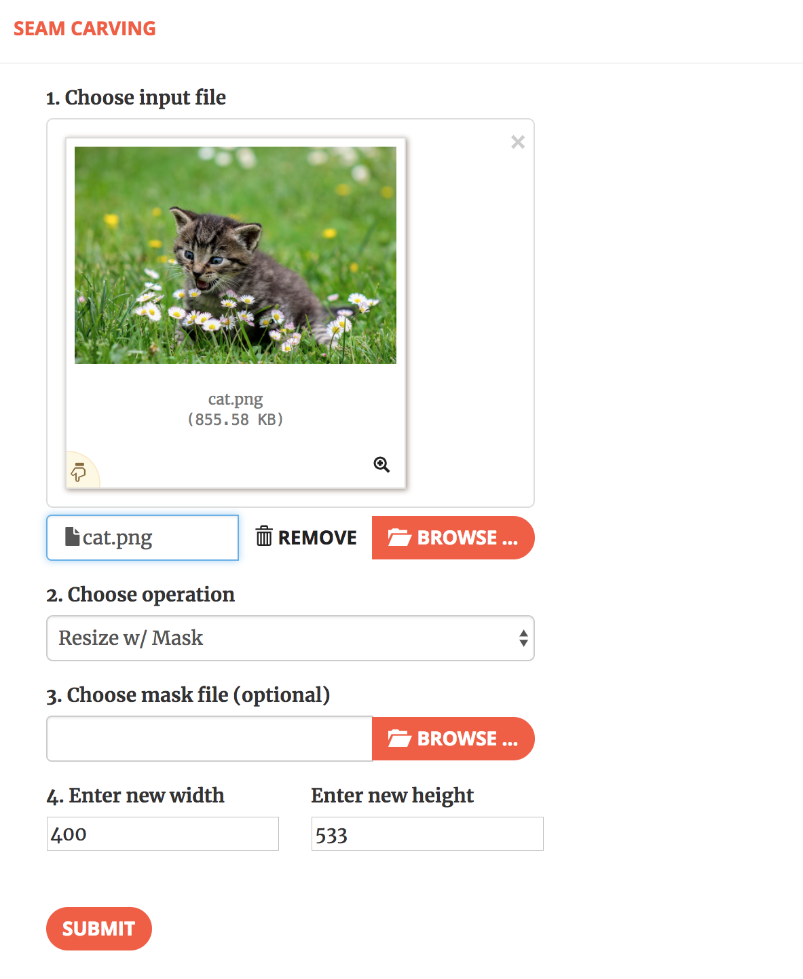
Web Application
Notes:
We have designed a web application using Django, here is the user interface.

Slide 17
Conclusions
1 We implemented seam carving operator using dynamic programming algorithm for image reduction and expansion, which can achieve better results than simply cropping or scaling
2 We used seam carving operator to achieve some other interesting applications including content amplification and object removal
3 We implemented improved seam carving operator using forward energy to improve visual quality of the retargeted image results
4 We implemented improved seam carving operator using forward energy and graph cut algorithm to retarget video
Notes:
In summary, we have successfully implemented seam carving operator using dynamic programming algorithm for image resizing and improved seam carving operator using forward energy and graph cut algorithm for image and video retargeting.

Slide 18
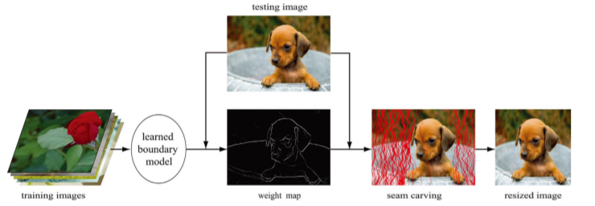
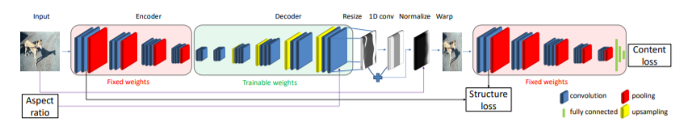
Conclusions
Machine Learning on Image and Video Resizing
Learning to resize image
Weakly- and Self-Supervised Learning for Content-Aware Deep Image Retargeting
Notes:
Further, we’d like to try some parallel framework to increase the speed of video retargeting and try to look into machine learning techniques on image and video resizing

Slide 19
References
[1] Shai Avidan and Ariel Shamir. Seam carving for content-aware image
resizing. In ACM Transactions on graphics (TOG), volume 26, page 10. ACM, 2007.
[2] Michael Rubinstein, Ariel Shamir, and Shai Avidan. Improved seam
carving for video retargeting. ACM transactions on graphics (TOG), 27(3):16, 2008.
[3] Carsten Rother, Vladimir Kolmogorov, and Andrew Blake. Grabcut:
Interactive foreground extraction using iterated graph cuts. In ACM transactions on graphics (TOG) , volume 23, pages 309–314. ACM, 2004.

Slide 20
Seam Carving for Content-Aware Image Resizing and Video Retargeting
Qian Zhang, Wolong Yuan

